Slide 1



Programming for Data Analysis (PDAS)
ST1510
CA2 PROJECT
How do factors such as degree specialisation, industry, gender, and competitiveness affect employment outcomes and salary in Singapore?
Name: Goh Kun Ming, Goh Jenson
Admin No: P2415691, P2401380
Class: DAAA/FT/1B/02

Slide 2


THE TEAM

Slide 3


SUMMARY OF STEPS
Cleaning Data
Cleaning Data
All Datasets were cleaned such as removing duplicated rows and addressing abnornallies.
Imputing Missing Data
Imputing Missing Data
Data Columns with Missing Data were imputed using various techniques such as median, interpolate, etc.
Removing Outliers
Removing Outliers
Outliers from normalised salary were removed using the IQR Method to prevent inaccurate Data Analysis.
Feature Engineering
Feature Engineering
New Features were created to summarised certain data columns which aided in Data Analysis.
Data Analysis & Visualisation
Data Analysis & Visualisation
Data Analysis and Visualisation were conducted on the cleaned data which showed proportions and relationships

Slide 4
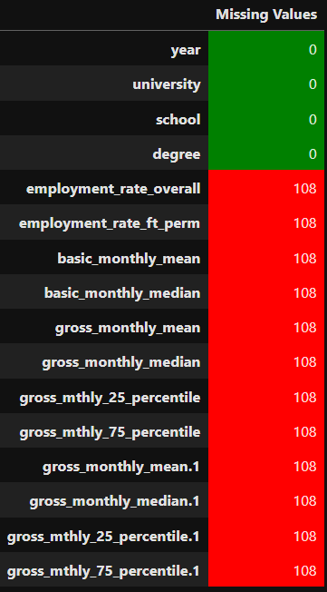
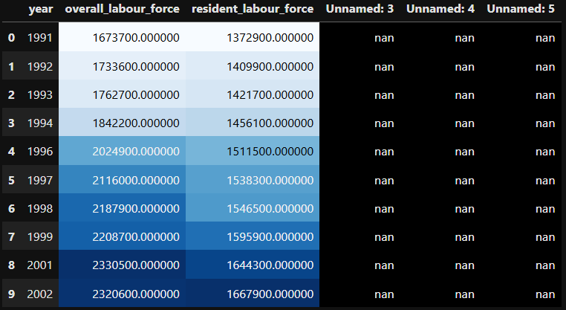
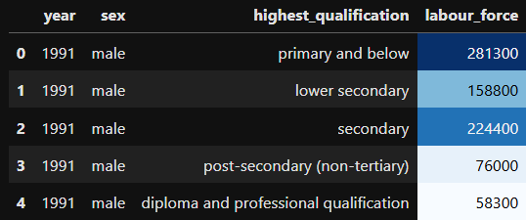
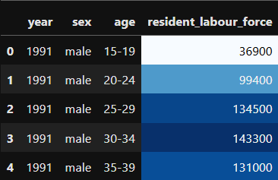
DATASETS
DF1
DF2
DF 3
DF4

Slide 5
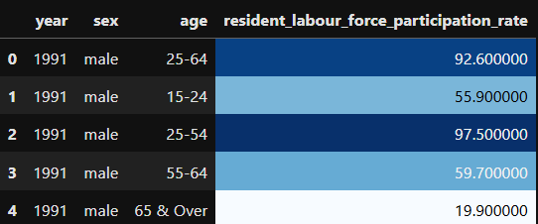
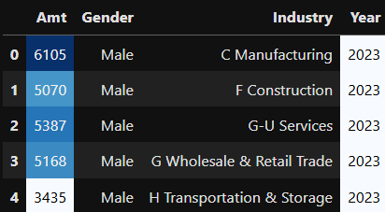
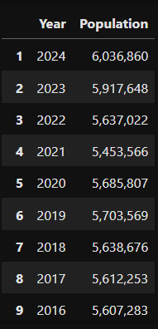
DATASETS
DF5
DF6
DF7

Slide 6
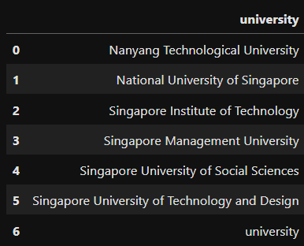



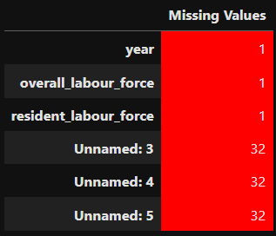
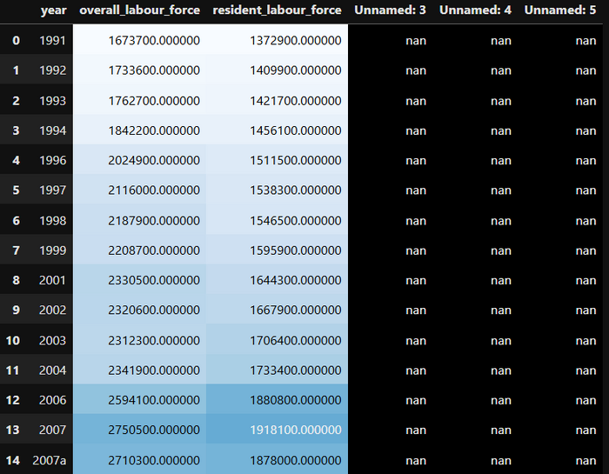
DATA CLEANING USING PANDAS
ADDRESSING ABNORMALLIES
IDENTIFYING MISSING DATA
REMOVING DUPLICATED DATA

Slide 7
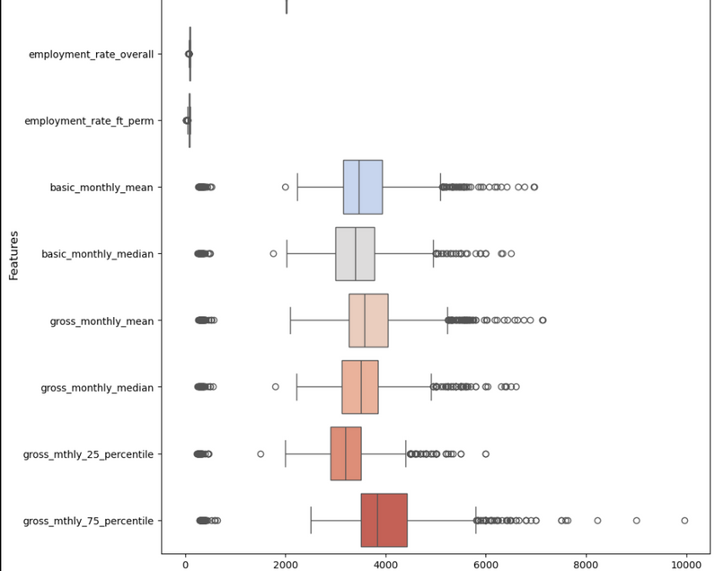
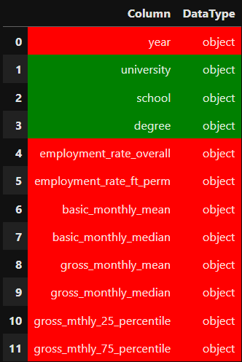
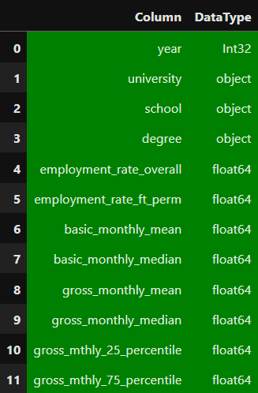

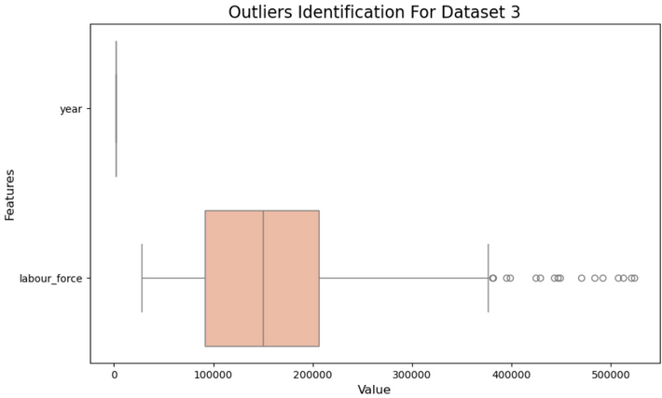
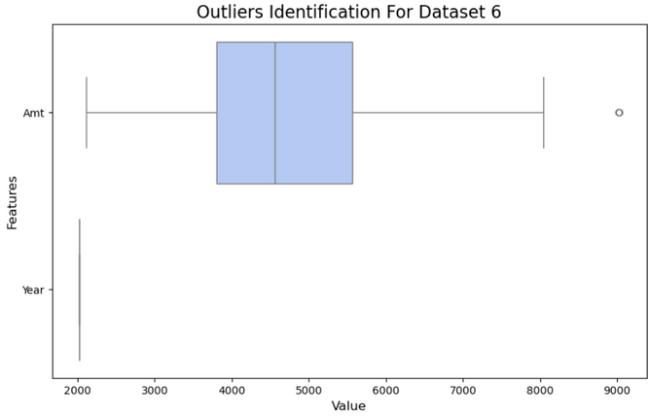
DATA WRAGLING & ANALYSIS USING PANDAS
CORRECTING DATA TYPES
ADDRESSING
OUTLIERS

Slide 8
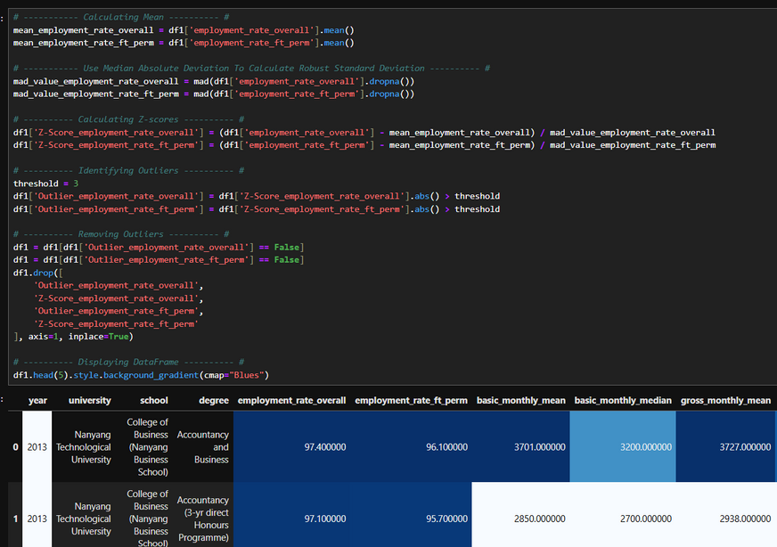
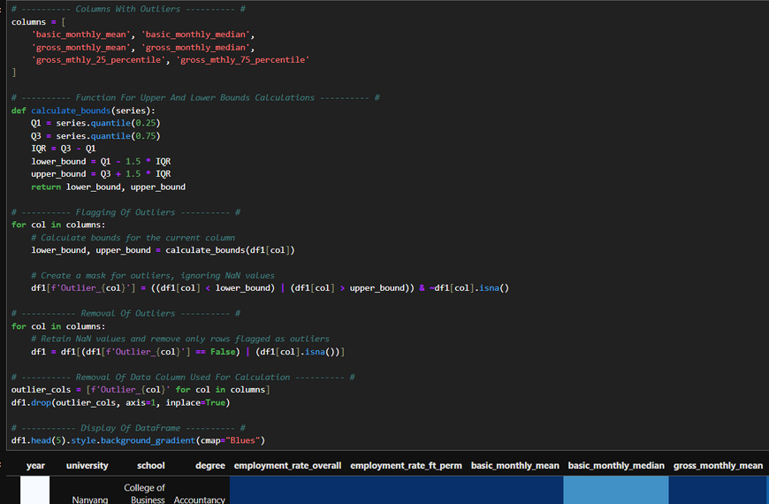
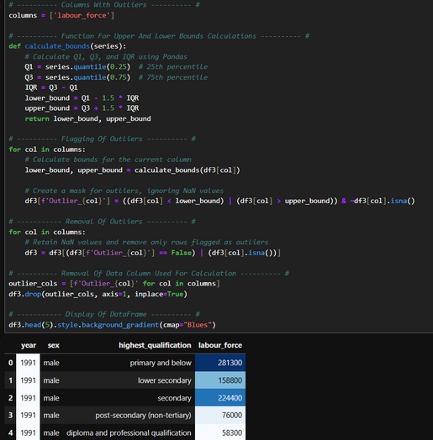
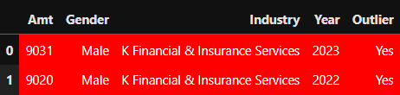
DATA WRAGLING & ANALYSIS USING PANDAS
OUTLIERS REMOVAL (IQR)
OUTLIERS REMOVAL (Z-SCORE)
ADDRESSING OUTLIERS

Slide 9
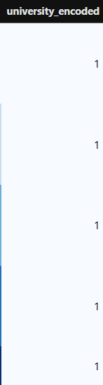
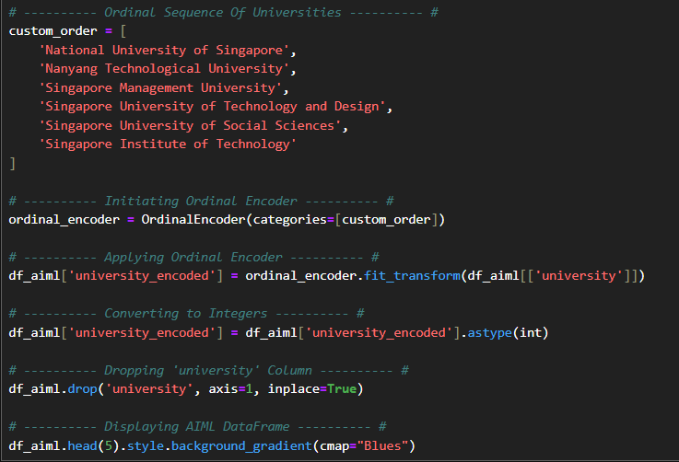
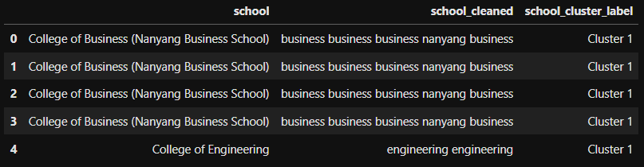
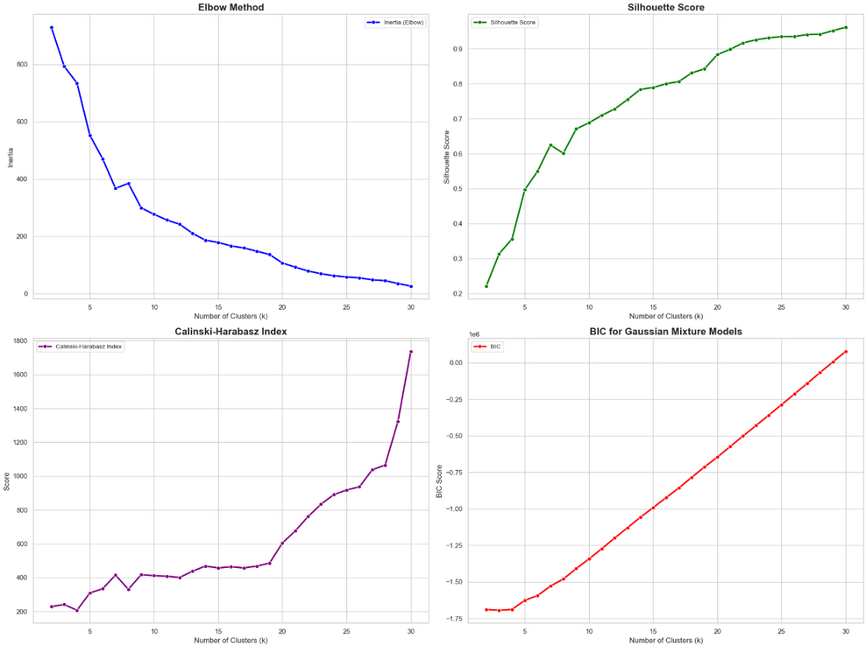
IMPUTING MISSING DATA
ORDINAL ENCODING
VECTORISER AND CLUSTERING

Slide 10
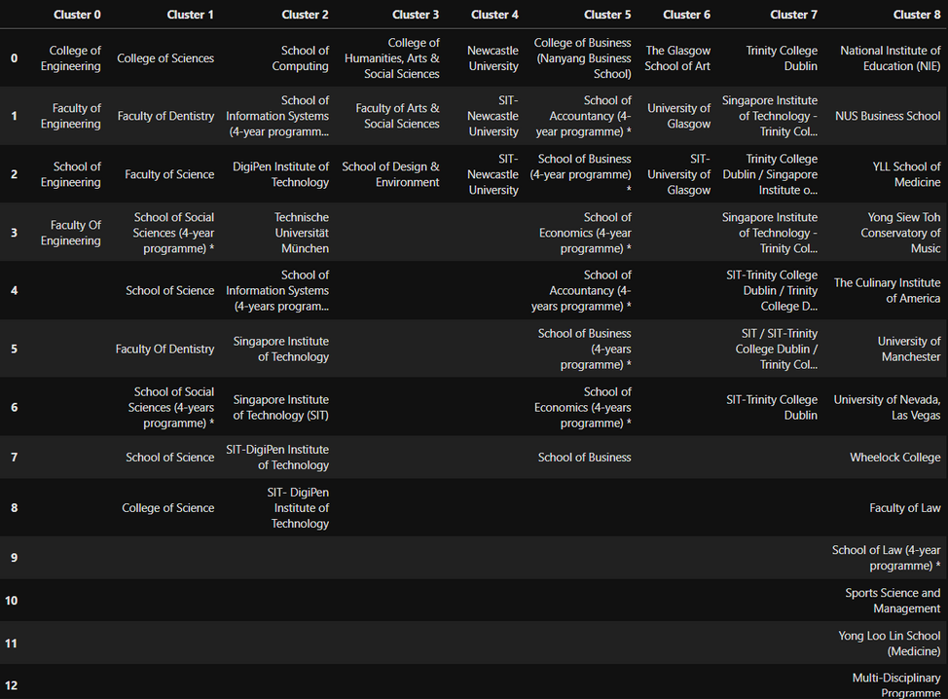
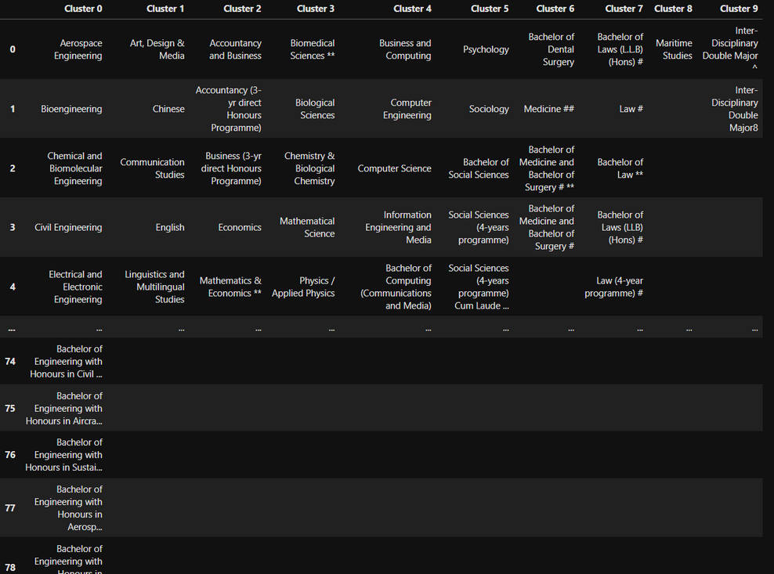
IMPUTING MISSING DATA
FINAL SCHOOL CLUSTER
FINAL DEGREE CLUSTER

Slide 11
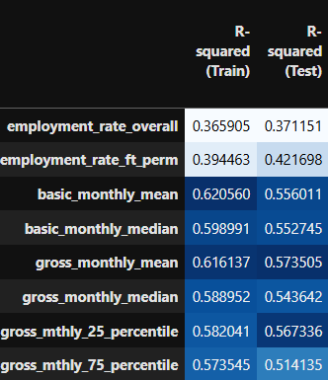
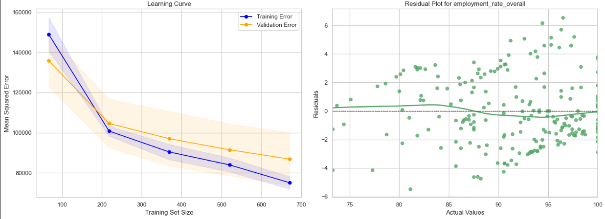
IMPUTING MISSING DATA
RANDOM FOREST REGRESSOR
RFR ACCURACY

Slide 12
IMPUTING MISSING DATA
RANDOM FOREST REGRESSOR
RFR ACCURACY

Slide 13
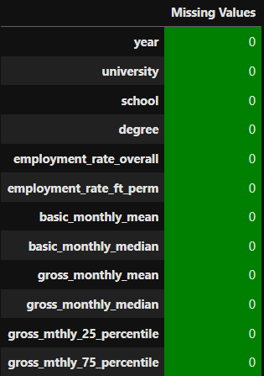
IMPUTING MISSING DATA
RFR DEPLOYMENT

Slide 14
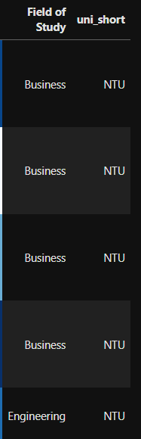
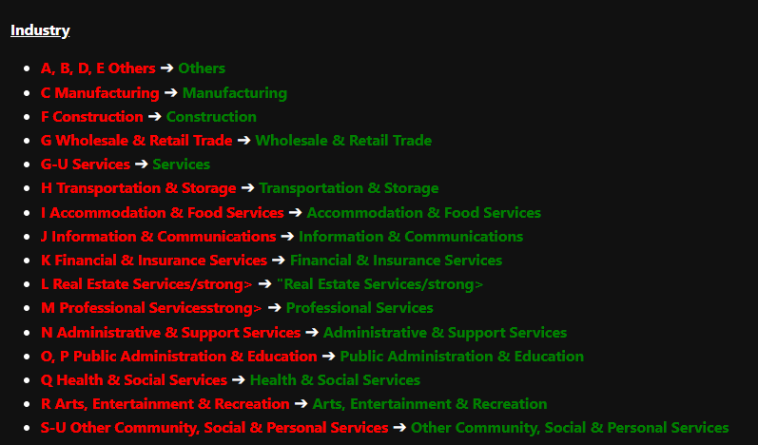
DATA WRAGLING & ANALYSIS USING PANDAS
FEATURE ENGINEERING
STANDARDISING CATEGORICAL DATA

Slide 15
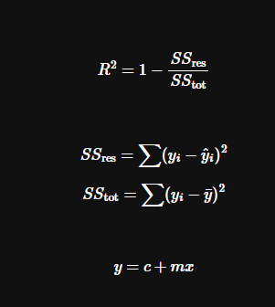
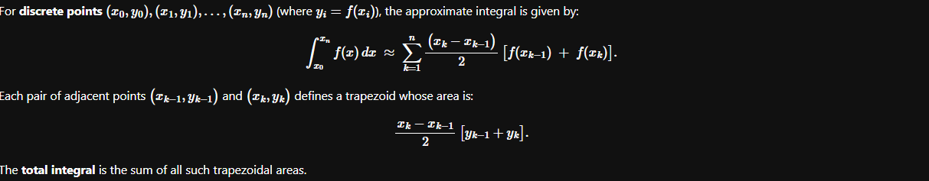
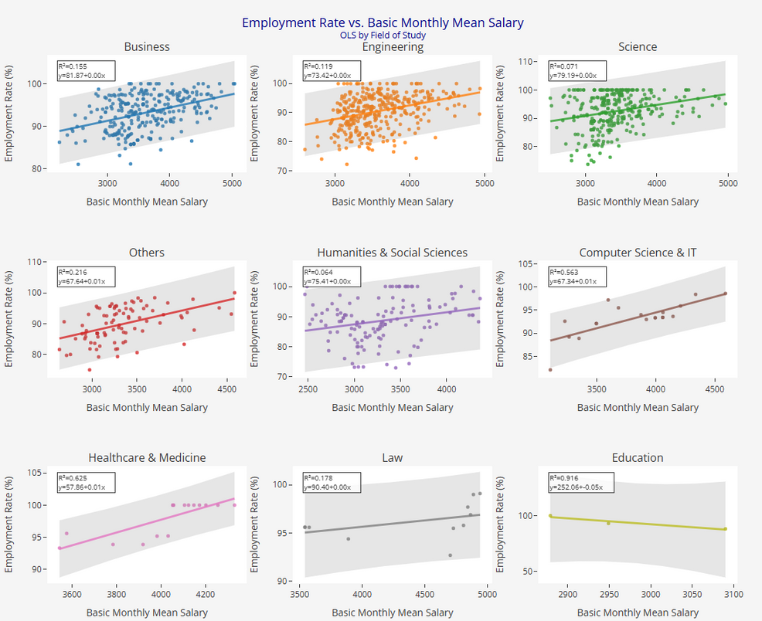
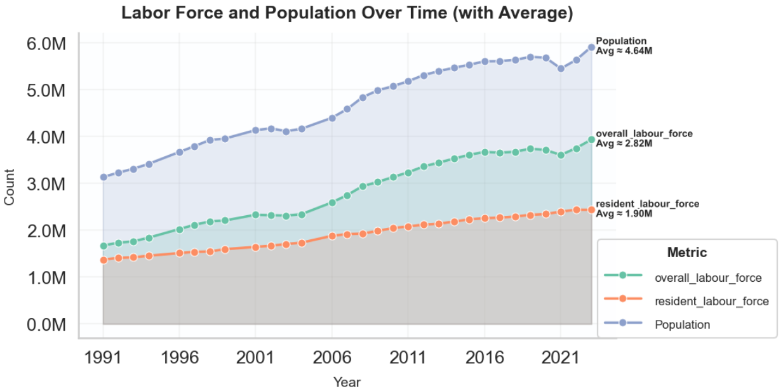
DATA VISUALISATION
LABOUR FORCE & POPULATION OVER TIME
SALARY VS. EMPLOYMENT RATE BY DEGREE

Slide 16
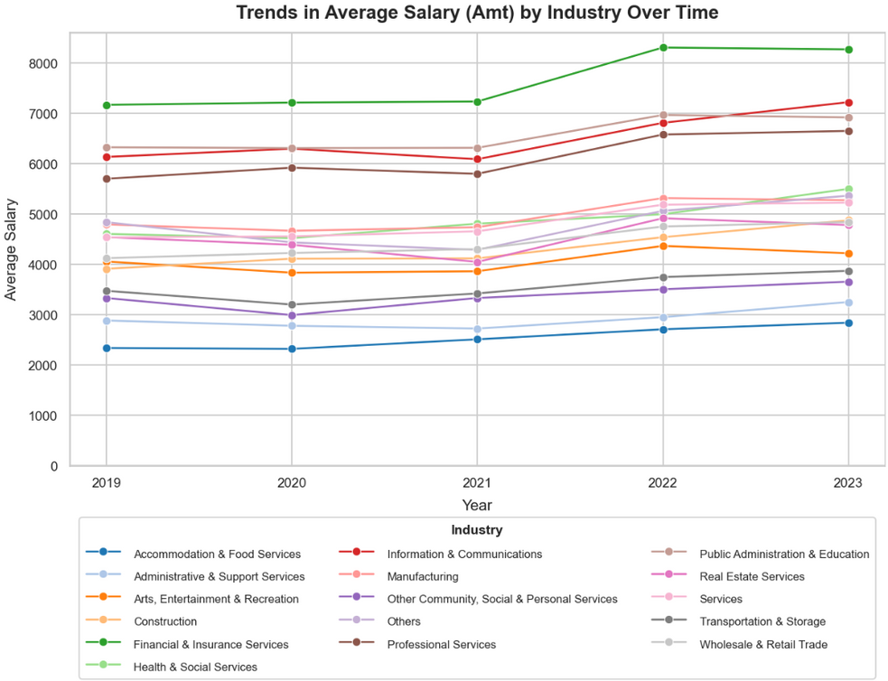
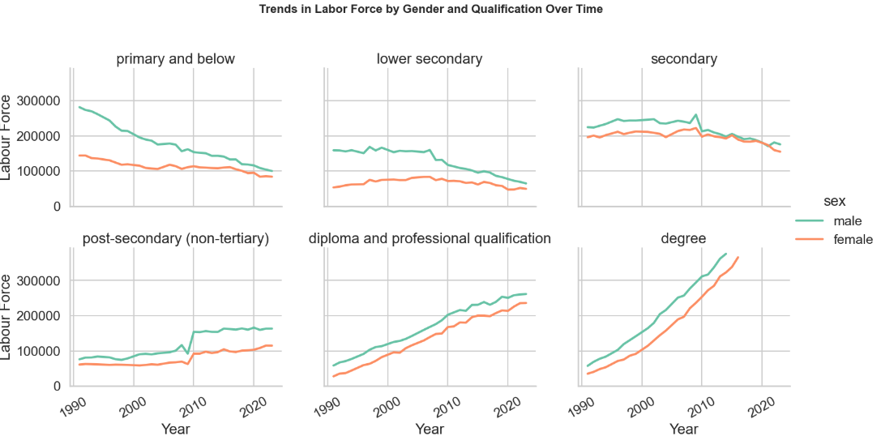
DATA VISUALISATION
TRENDS IN AVERAGE SALARY ACROSS INDUSTRIES OVER TIME
LABOUR FORCE BY GENDER AND HIGHEST QUALIFICATIONS OVER YEAR

Slide 17
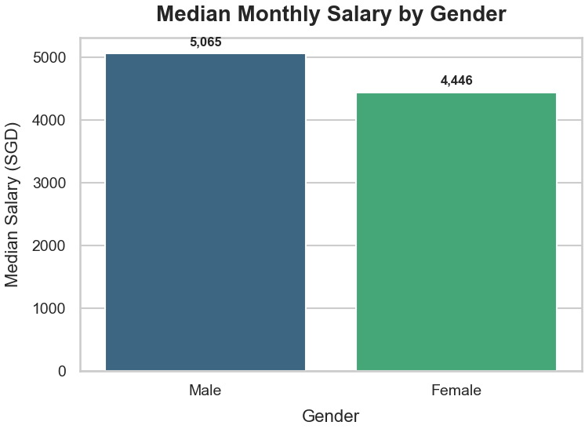
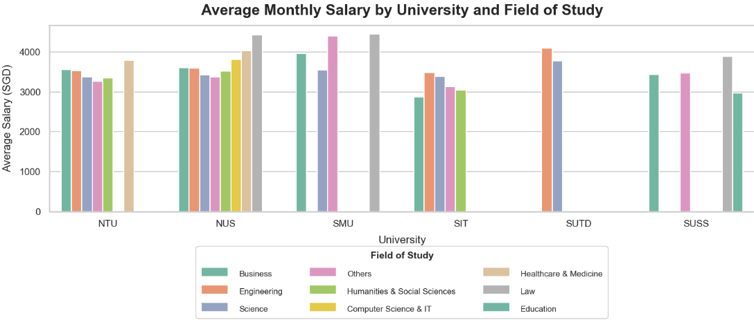
DATA VISUALISATION
AVERAGE MONTHLY SALARY BY UNIVERSITY AND FIELD OF STUDY
MEDIAN MONTHLY SALARY BY GENDER

Slide 18
DATA VISUALISATION
AVERAGE MONTHLY SALARY BY UNIVERSITY AND FIELD OF STUDY
MEDIAN MONTHLY SALARY BY GENDER

Slide 19
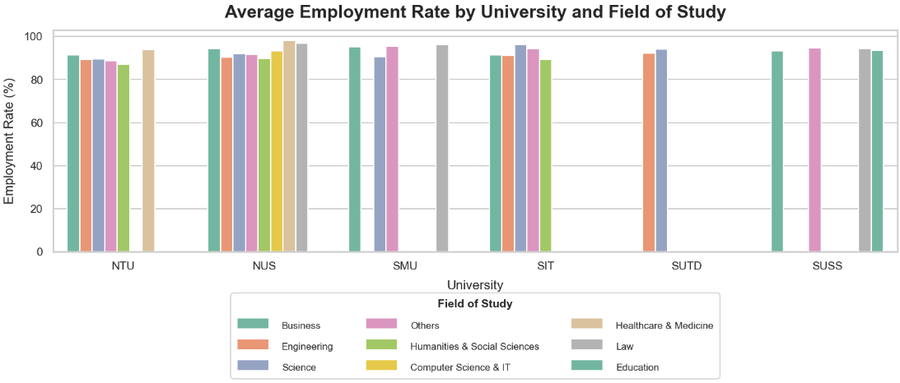
DATA VISUALISATION
AVERAGE EMPLOYMENT RATE BY UNIVERSITY AND FIELD OF STUDY

Slide 20
KEY INSIGHTS GATHERED
DIFFERENT UNIVERSITIES YIELD VARYING AVERAGE SALARIES AND EMPLOYMENT RATES, EVEN FOR THE SAME FIELD.
CERTAIN UNIS (E.G., NUS LAW) COMMAND HIGHER EMPLOYMENT OUTCOMES DUE TO STRONGER REPUTATIONS.
SALARIES GENERALLY RISE OVER TIME ACROSS INDUSTRIES.
FIANCNE AND TECHNOLOGY INDUSTRY HAS THE HIGHEST PAYING SALARY.
SALARY IS AFFECTED BY EXTERNAL FACTORS.
MALE–FEMALE WAGE DIFFERENCES ARE SMALL IN SINGAPORE.
THE INFLUX OF FOREIGN WORKERS RAISES SALARIES BUT ALSO INCREASES JOB MARKET COMPETITION.
MORE MEN AND WOMEN ATTAIN ADVANCED DEGREES, BOOSTING JOB MARKET COMPETITIVENESS.

Slide 21
THANK
YOU

